Slide 1
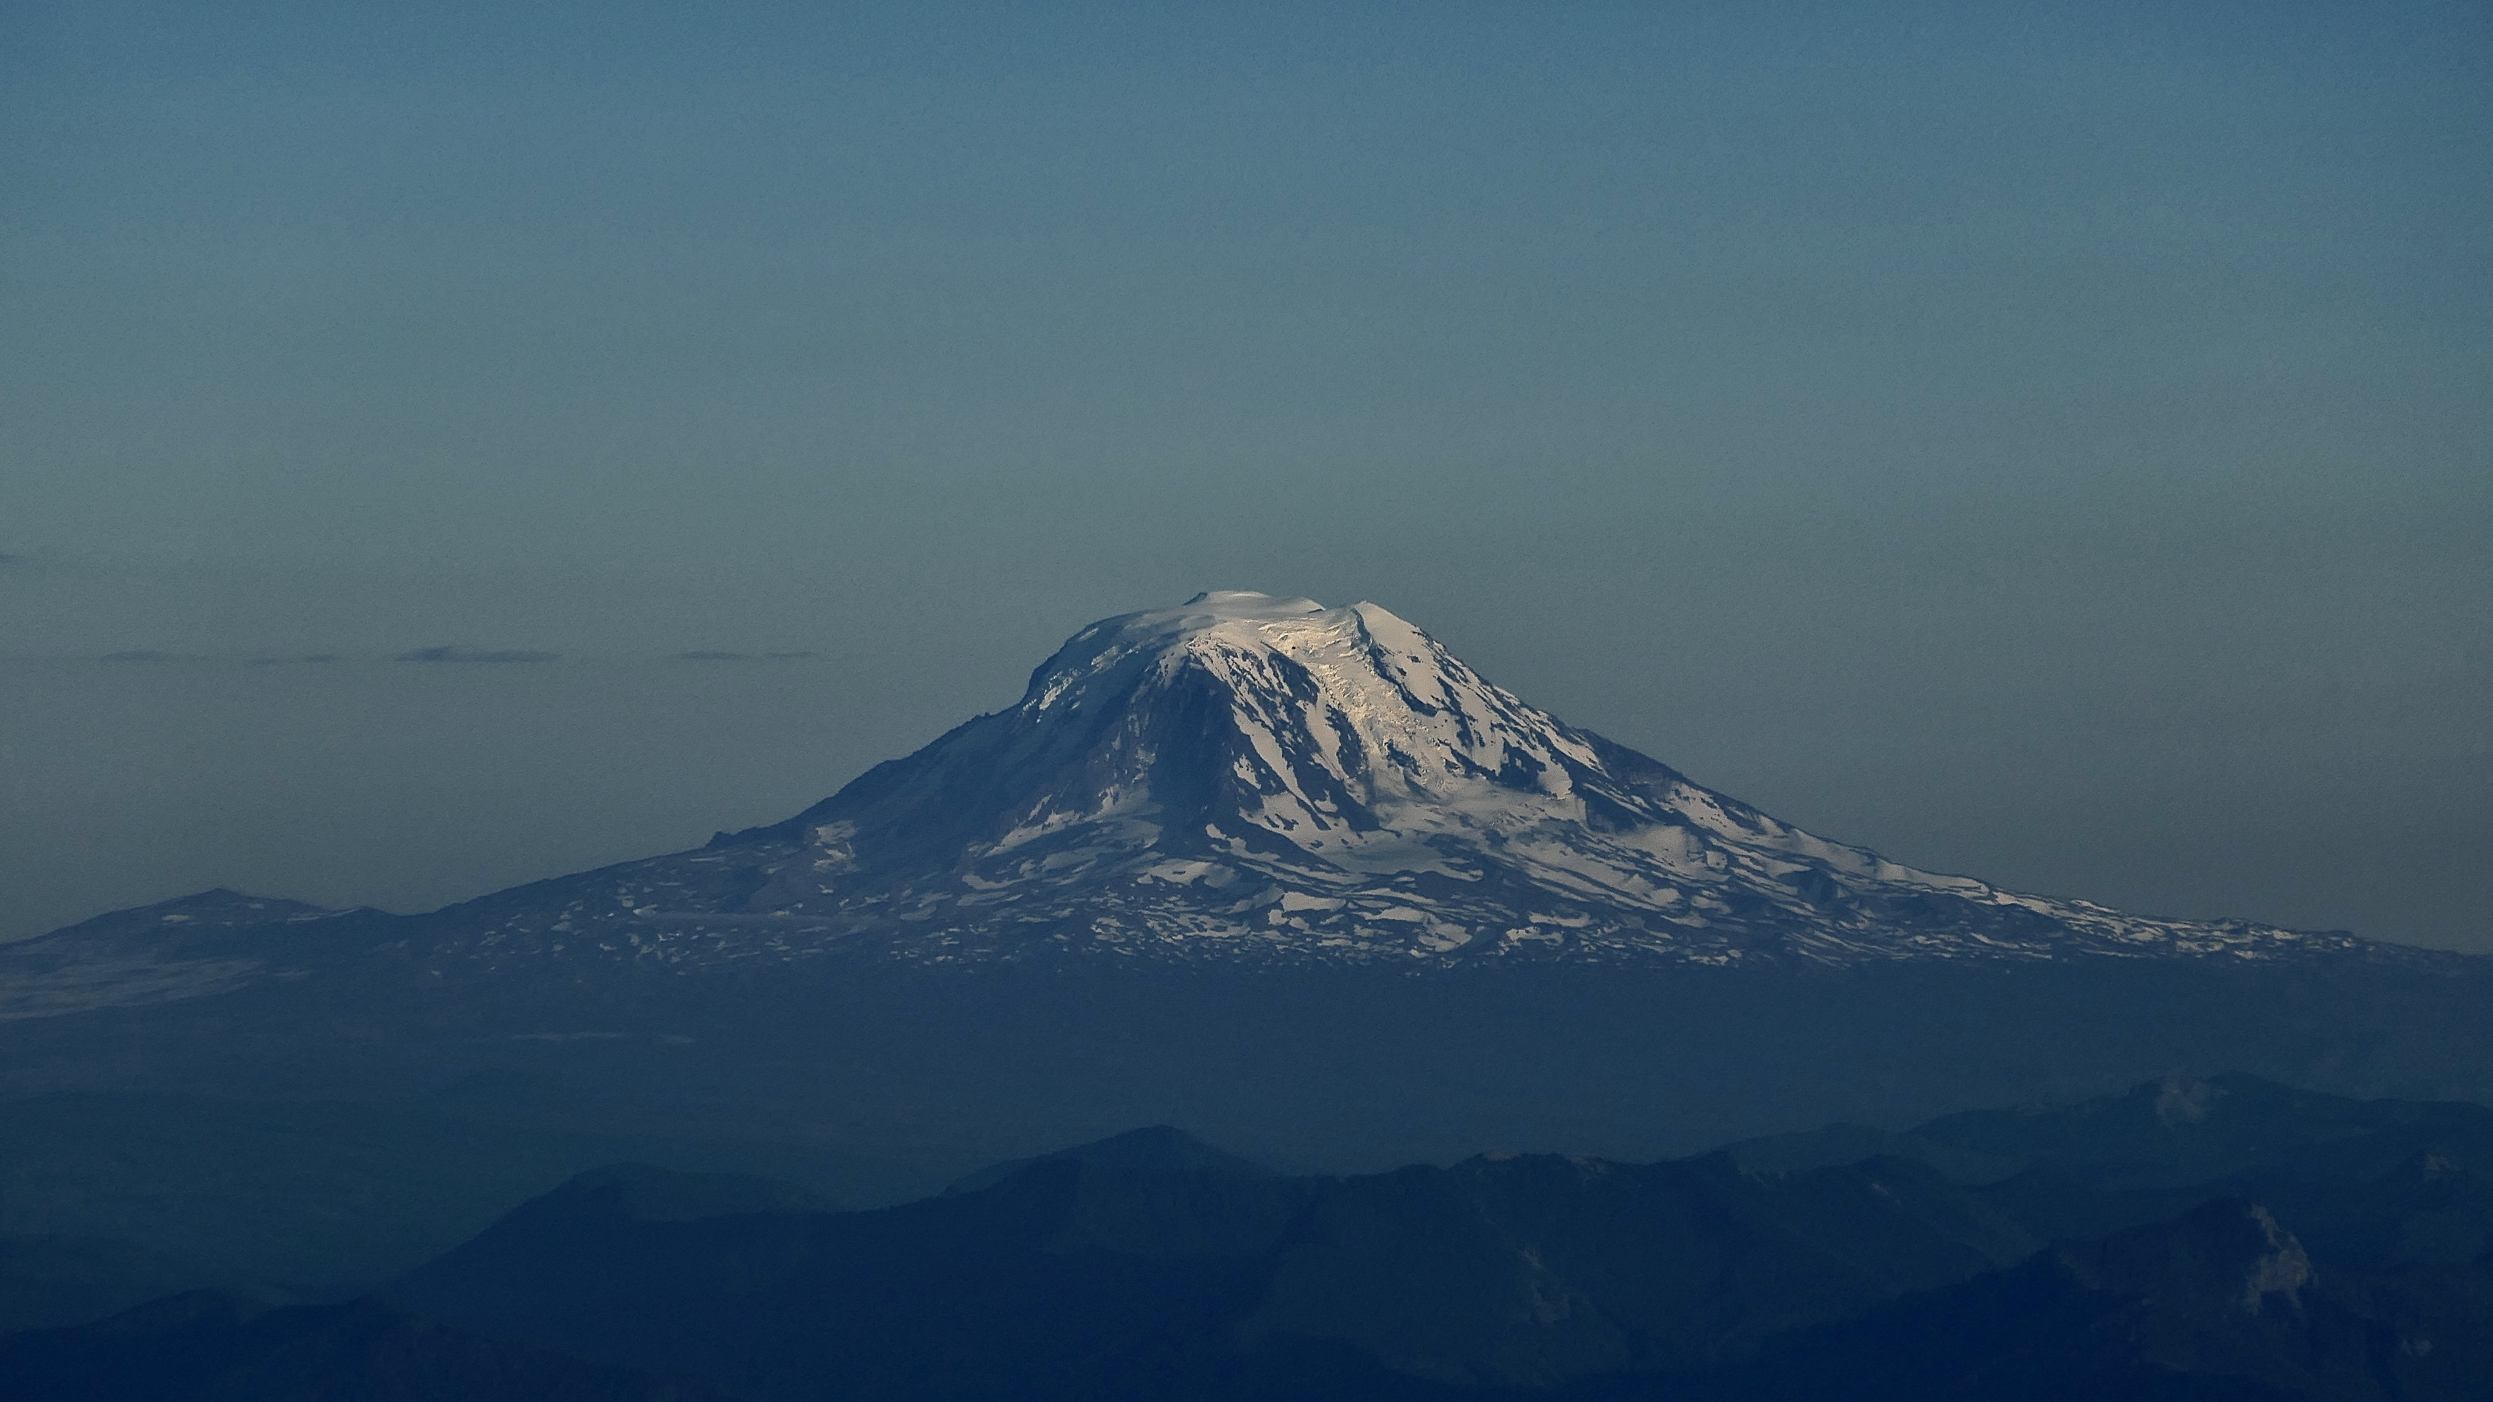
Carson Pass-Kirkwood Paleocanyon System: Paleogeography of the Ancestral Cascades Arc & Implications for Landscape Evolution of the Sierra Nevada (California)
Paper by Busby et al (2008)
Presentation by Solomon Feinstein

Slide 2
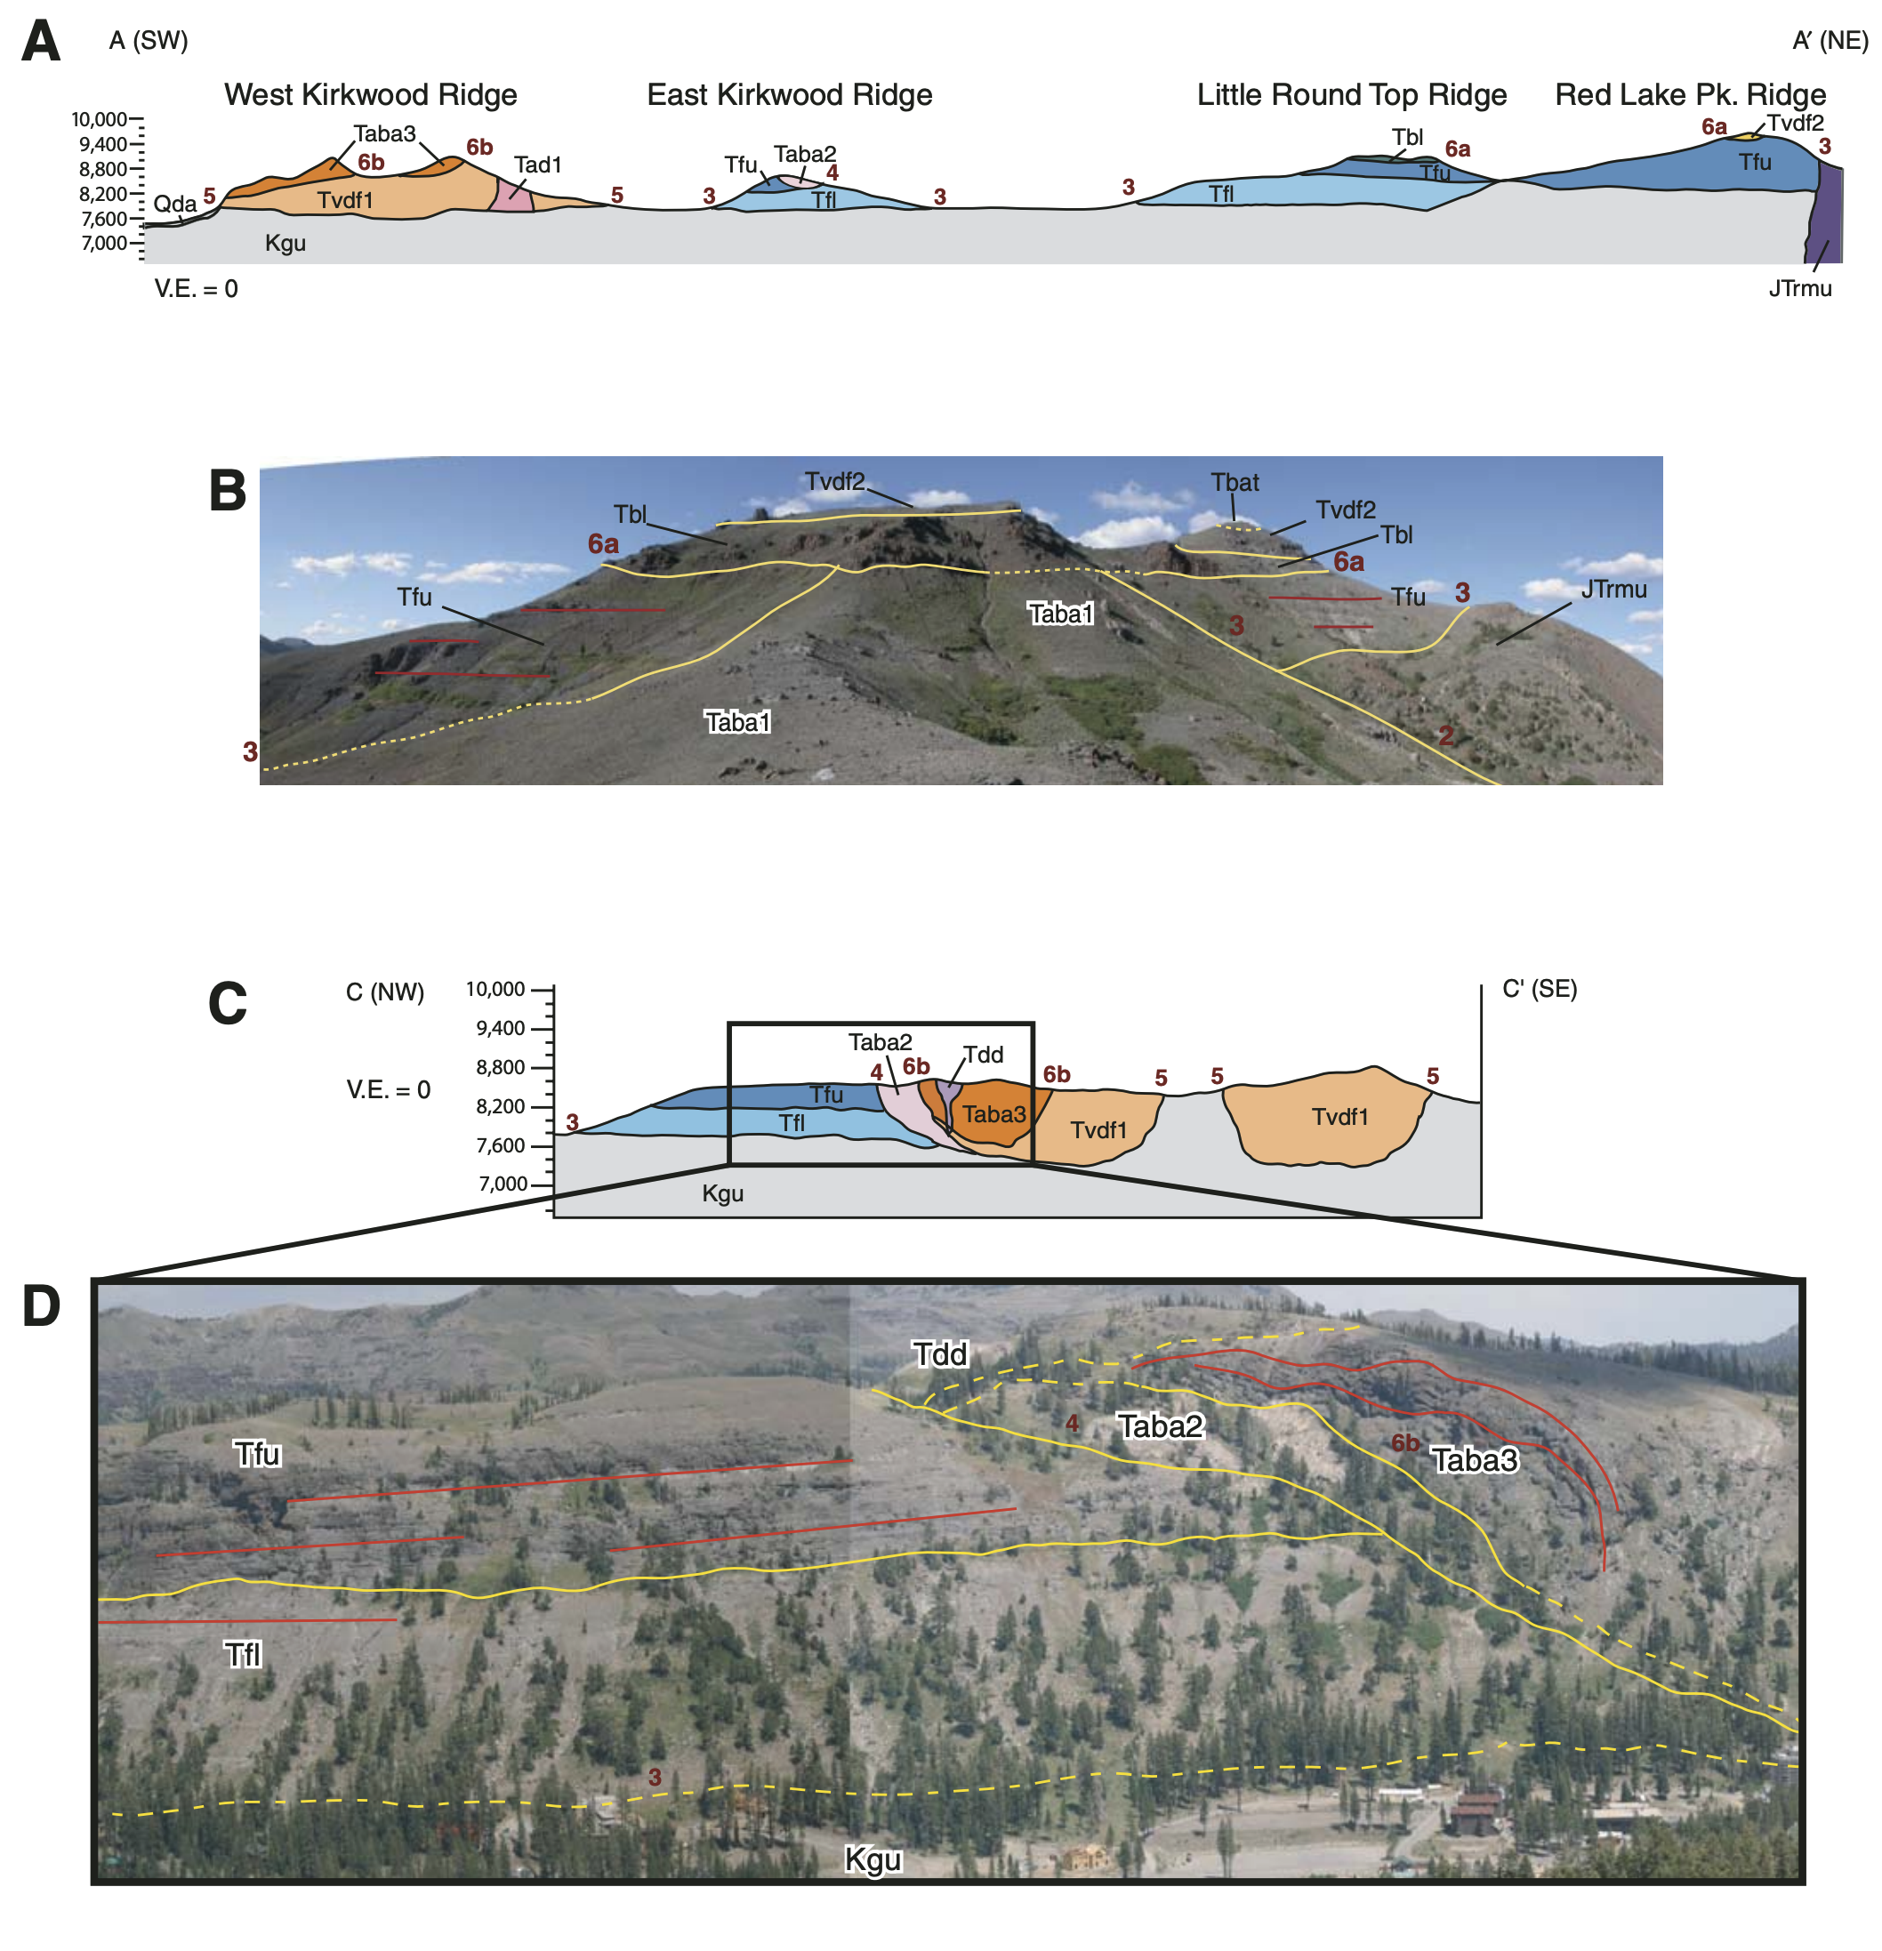
Quick Snapshot
Kirkwood Area contains several Tertiary volcanic sequences in Paleocanyons attributed to the Ancestral Cascades and Nevada Calderas
Volcanic units were previously undifferentiated, but this paper studies them in greater detail
This is important because these units shed light on the geologic history of the Central Sierras during the Miocene
Classic Geology was utilized, as was Ar/Ar Dating of units
6 Volcanic sequences, 6 unconformities, 14-6 MA

Slide 3
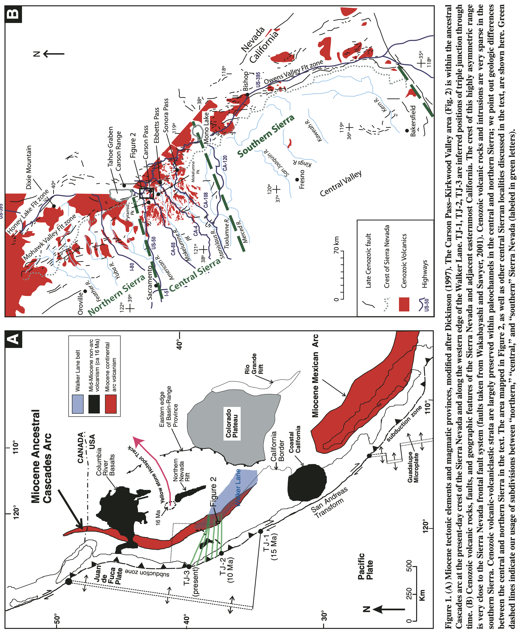

Slide 4
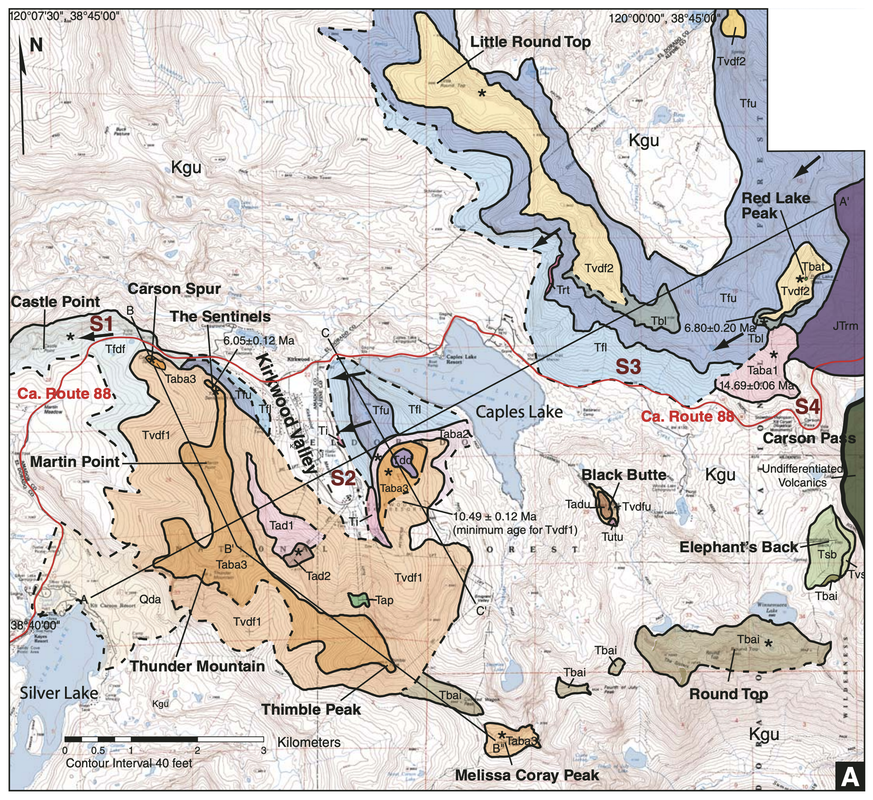
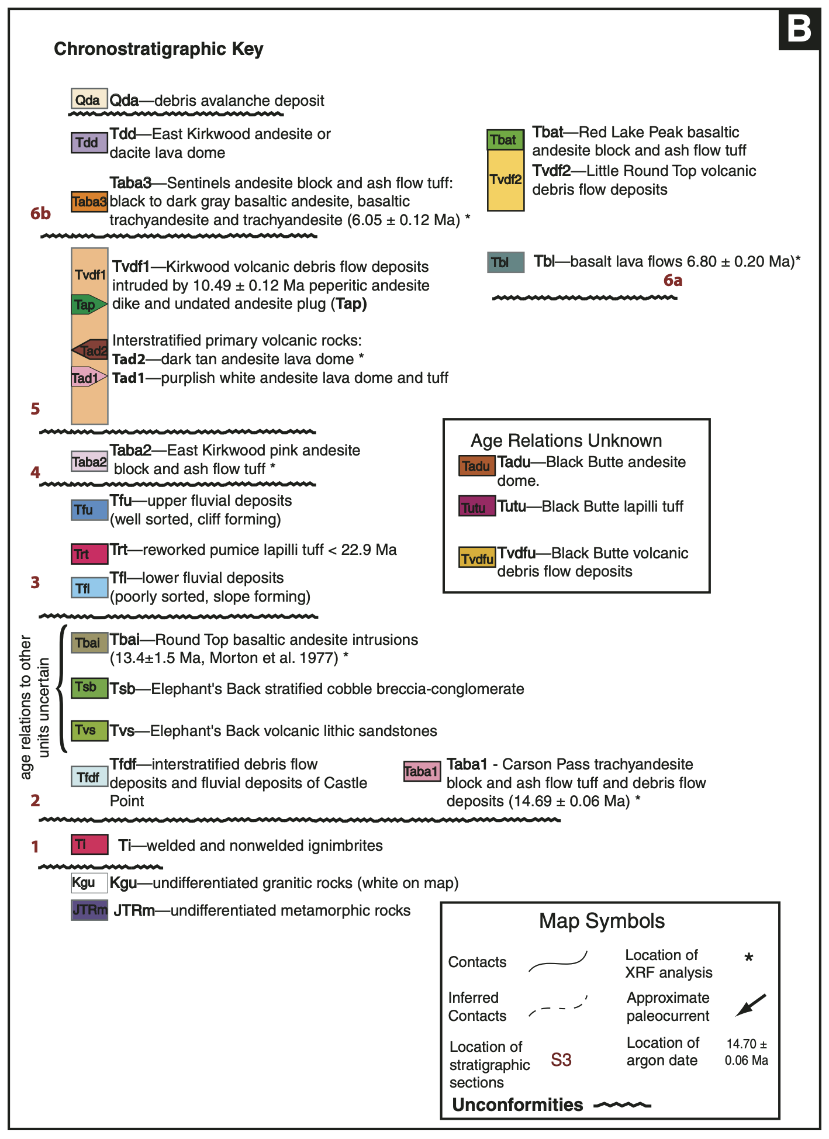

Slide 5
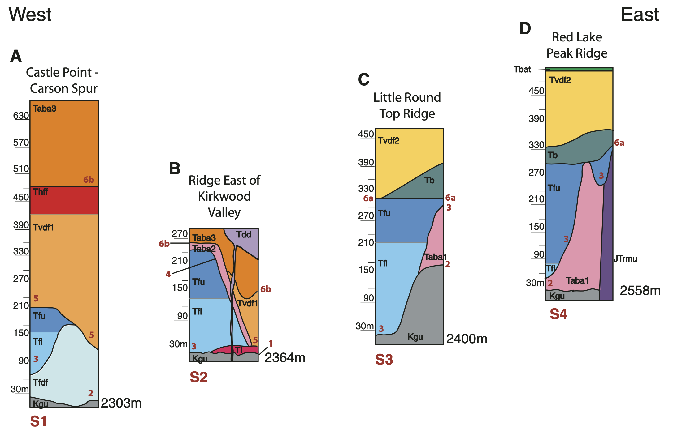
Volcanic Sequences and Unconformities
6 different volcanic sequences, ranging in age from Oligocene-6 MA
Each volcanic sequence is bounded by an unconformity
Sequences show differing characteristics, highlighting differences in volcanic depositional environments
Unconformities also show differing characteristic, shedding light on tectonics of the area

Slide 6
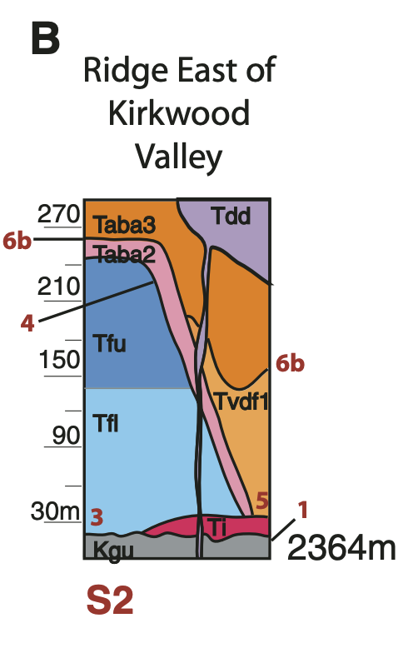
Sequence/Unconformity 1
U1 | S1
Either contact between granite basement & S1 or floor/walls of paleocanyon Occurred before S1 was deposited 12 – 650 m of relief Extends for 8 km Dipped 50º in Granite, 70º in Metamorphic Rock | Sanidine & Quartz bearing welded & non-welded Rhyolite ignimbrite No Ar/Ar date in this study, but dates back to Oligocene Distal facies, erupted from calderas in Nevada Originally thick, largely eroded Denoted as “Ti” on Geologic Map

Slide 7
Sequence/Unconformity 2
U2 | S2
In west, forms a channel cut into granitic basement and filled with volcanic debris-flow and fluvial deposits In east, forms a paleocanyon with preserved wall cut steeply into Jurassic Metamorphic Rock 170 – 291 m of relief Extends for 1.2 km Dipped 23º | Trachyandesite Blocks & Ash-Flow Tuff (14.69 +/- 0.06 MA) Volcanic Debris Flows Fluvial Deposits Volcano-sedimentary Sandstones, Conglomerates, & Breccia Shallow Basaltic Andesite Intrusions (13.4 +/- 1.5 MA K/Ar) Distal source Taba1, Tfdf, Tvs, Tsb, Tbai

Slide 8
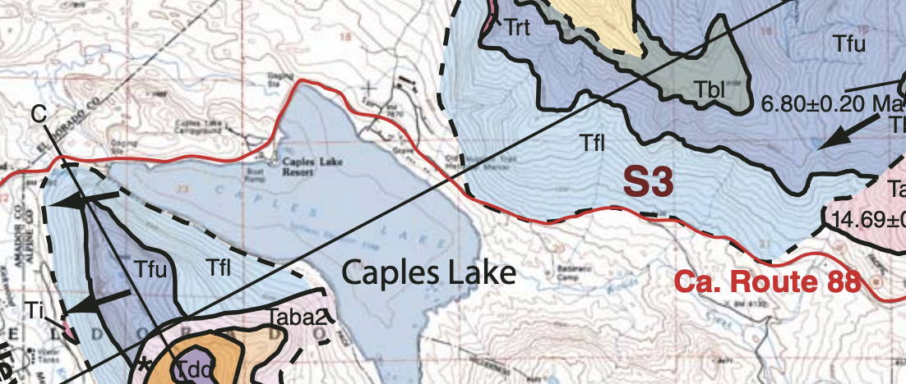
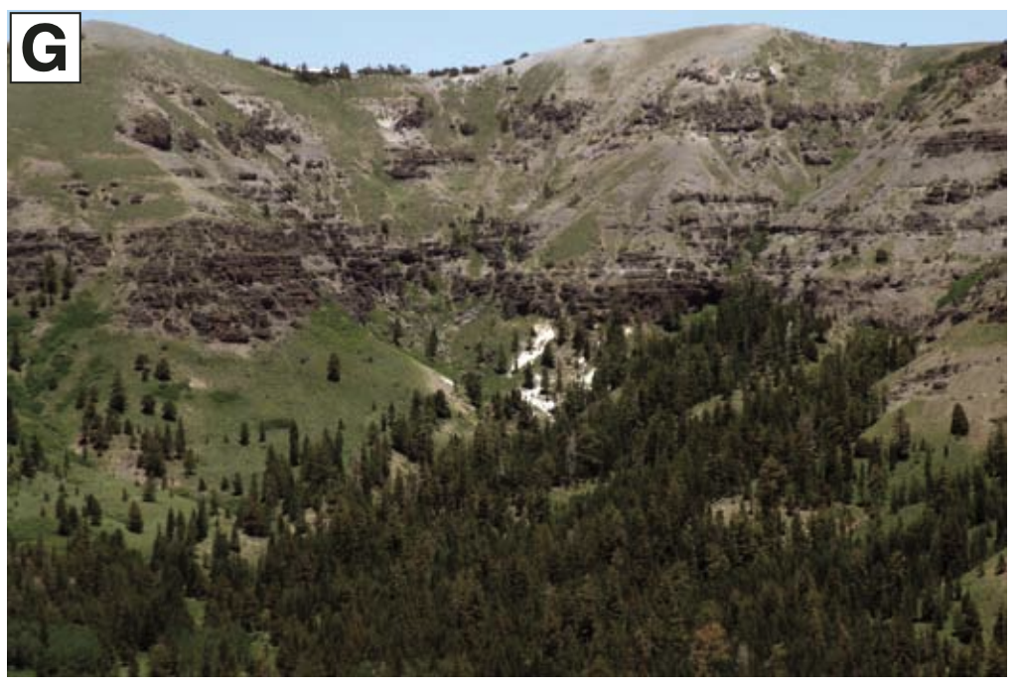
Sequence/Unconformity 3
U3 | S3
Underlies most widespread units in study area Underlies fluvial units Steeper where it cuts volcanics, gentler where it cuts granite Relief of 133 – 315 m Can be traced across paleocanyon and 18km down paleocanyon Dipped 6º | Braided stream deposits Lack interstratified volcanic debris, thus they probably record pause in volcanic activity, at least locally Andesitic clasts dominate, suggesting active source was east of area Contains clasts from Oligocene Nevada Calderas & 14 MA Ancestral Cascades Tfl, Trt, Tfu

Slide 9
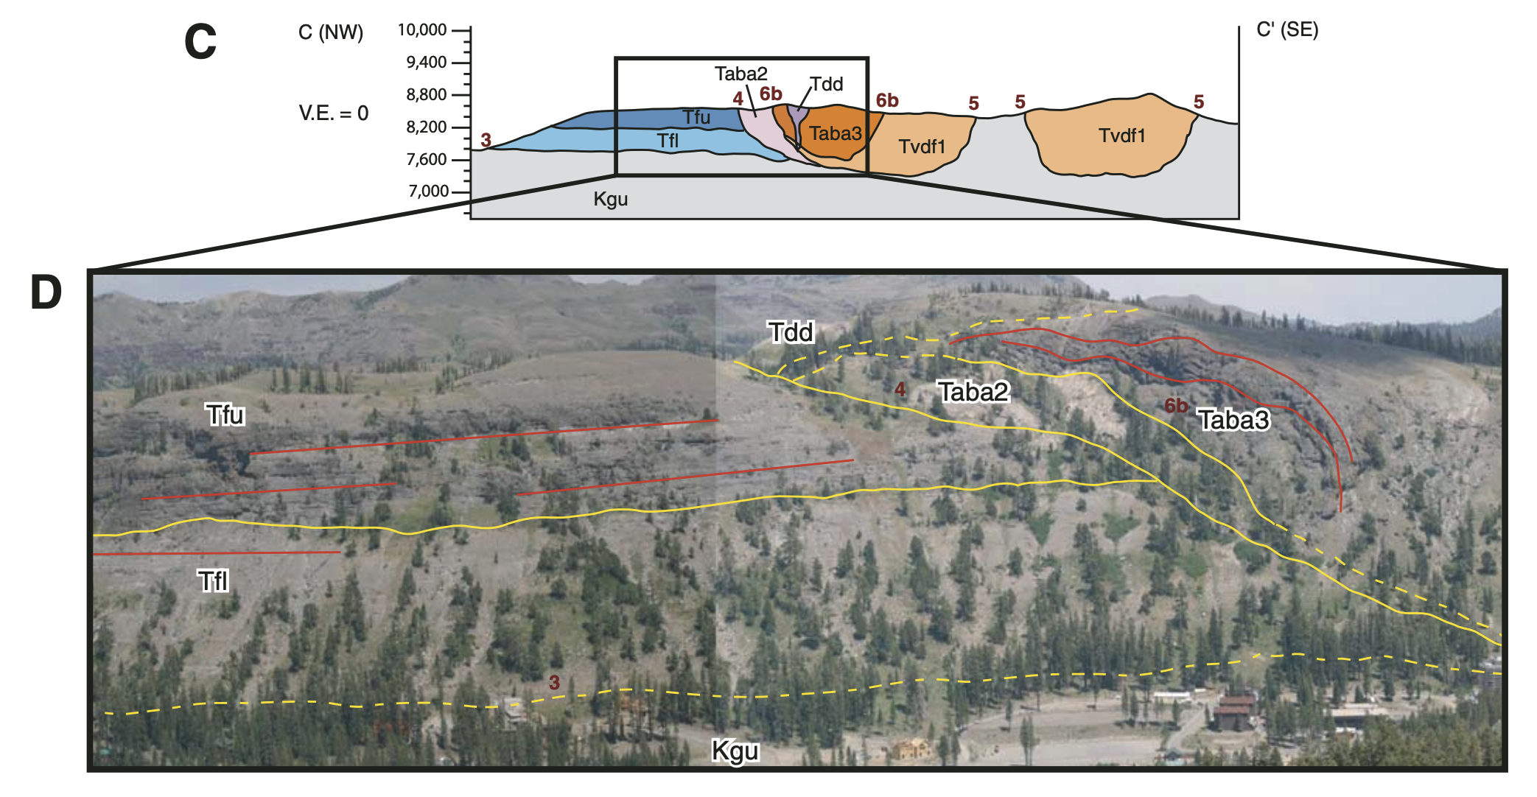
Sequence/Unconformity 4
U4 | S4
Only occurs on east side of Kirkwood Valley Forms a paleocanyon wall where S3 is deeply incised 167 – 227 m of relief Extends for 1.4 km Dipped 32º | Andesite block & ash flow tuff Vent-proximal deposit, indicating return of volcanism in area after hiatus (recorded in S3) Contains abundant Hornblende Taba2

Slide 10
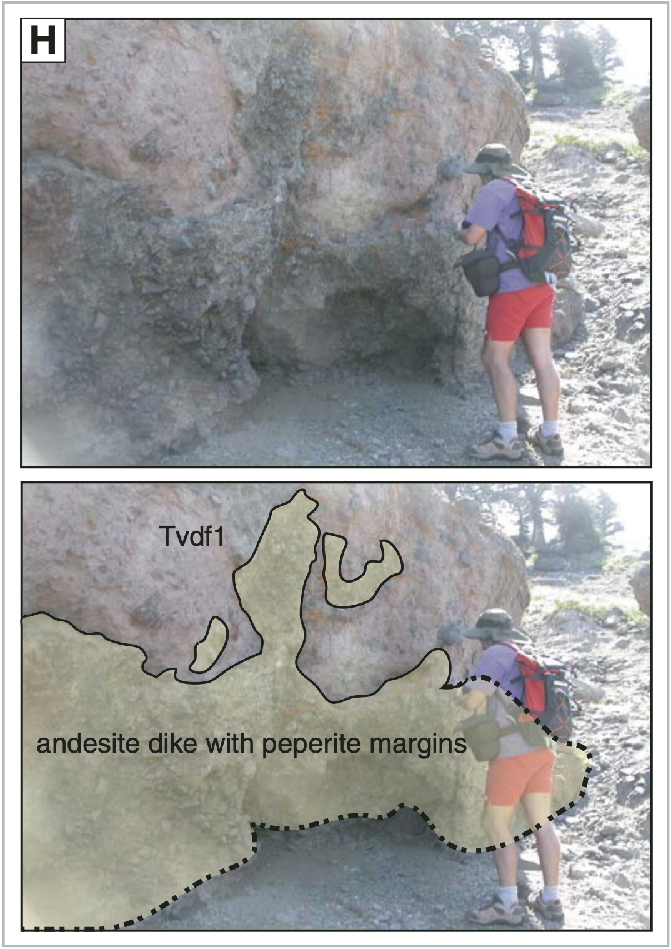
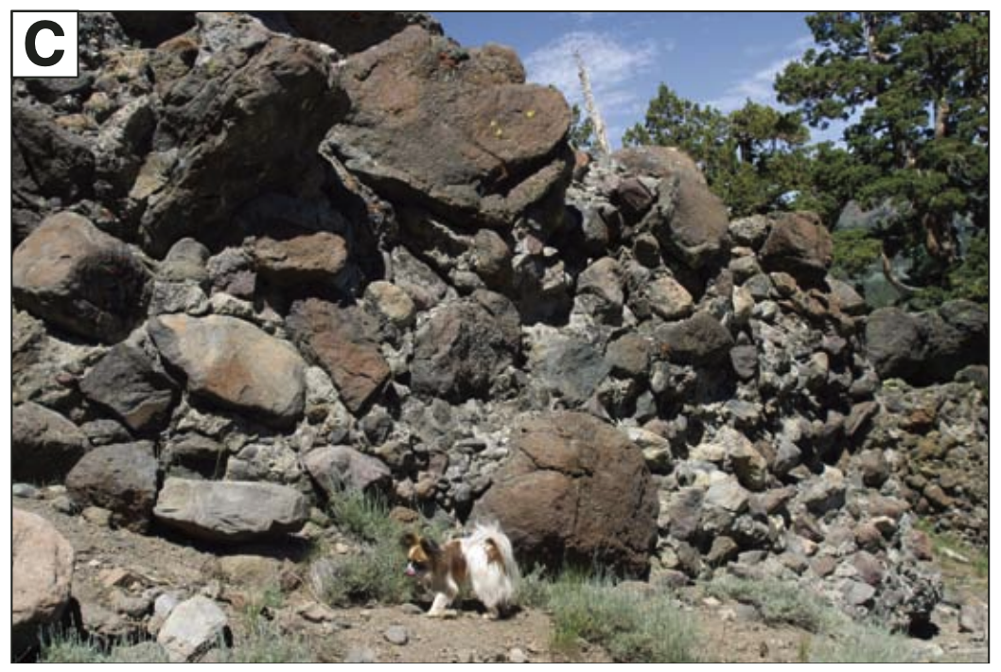
Sequence/Unconformity 5
U5 | S5
Occurs on west side of study area Cuts through S2 & S3 down to Granite Very deep unconformity 85 – 200 m of relief Extent of 4.2 km 32º Paleoslope Gradient | Up to 300 m thick Contains very large clasts/boulders, some as large as 10s of meters This suggests proximal source for volcanic debris flow Interstratified with intrusions that pass up and out to form a lava dome, dome breccia, & tuff Records volcanism within paleocanyon Cut by dike with perperite margins Dike was intruded while debris flow was still waterlogged, related to debris flow deposits Dike 10.49 +/- 0.12 MA Tvdf1, Tad1, Tad2

Slide 11
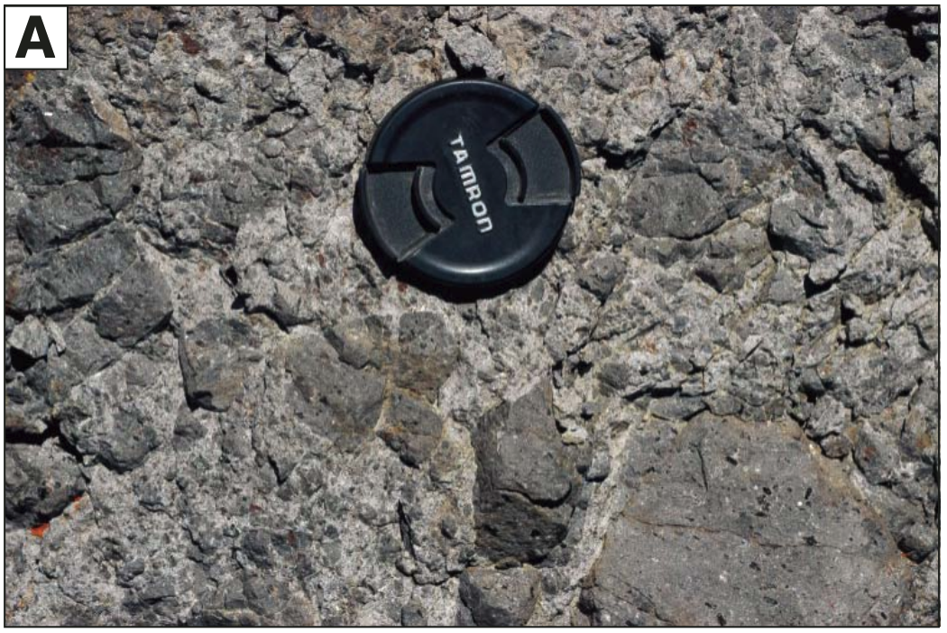
Sequence/Unconformity 6
U6 | S6a | S6b
Divided into U6a & U6b due to geography (6a in E, 6b in W) Despite this, likely correlated and record related volcanism Basal strata of 6a 0.75-1.1 MY older than 6b Very deep unconformity within paleocanyon U6a: 36 – 303 m of relief, dipped 48º, extends 6.0 km U6b: 121 – 303 m of relief, dipped 6º, extends 5.0 km | 4 young basalt flows 6.80 +/- 0.20 MA (Ar/Ar) Volcanic debris flow as well, cut by perperite dike, overlaying young basalt Basaltic andesite block & ask flow tuff of Red Lake Peak Forms highest point in paleocanyon 170m thick, deposited in 0.75 MY TbI, Tvdf2, Tbat | Petrographically distinct from other volcanic rocks 6.05 +/- 0.12 MA (Ar/Ar) Taba3, Tdd

Slide 12
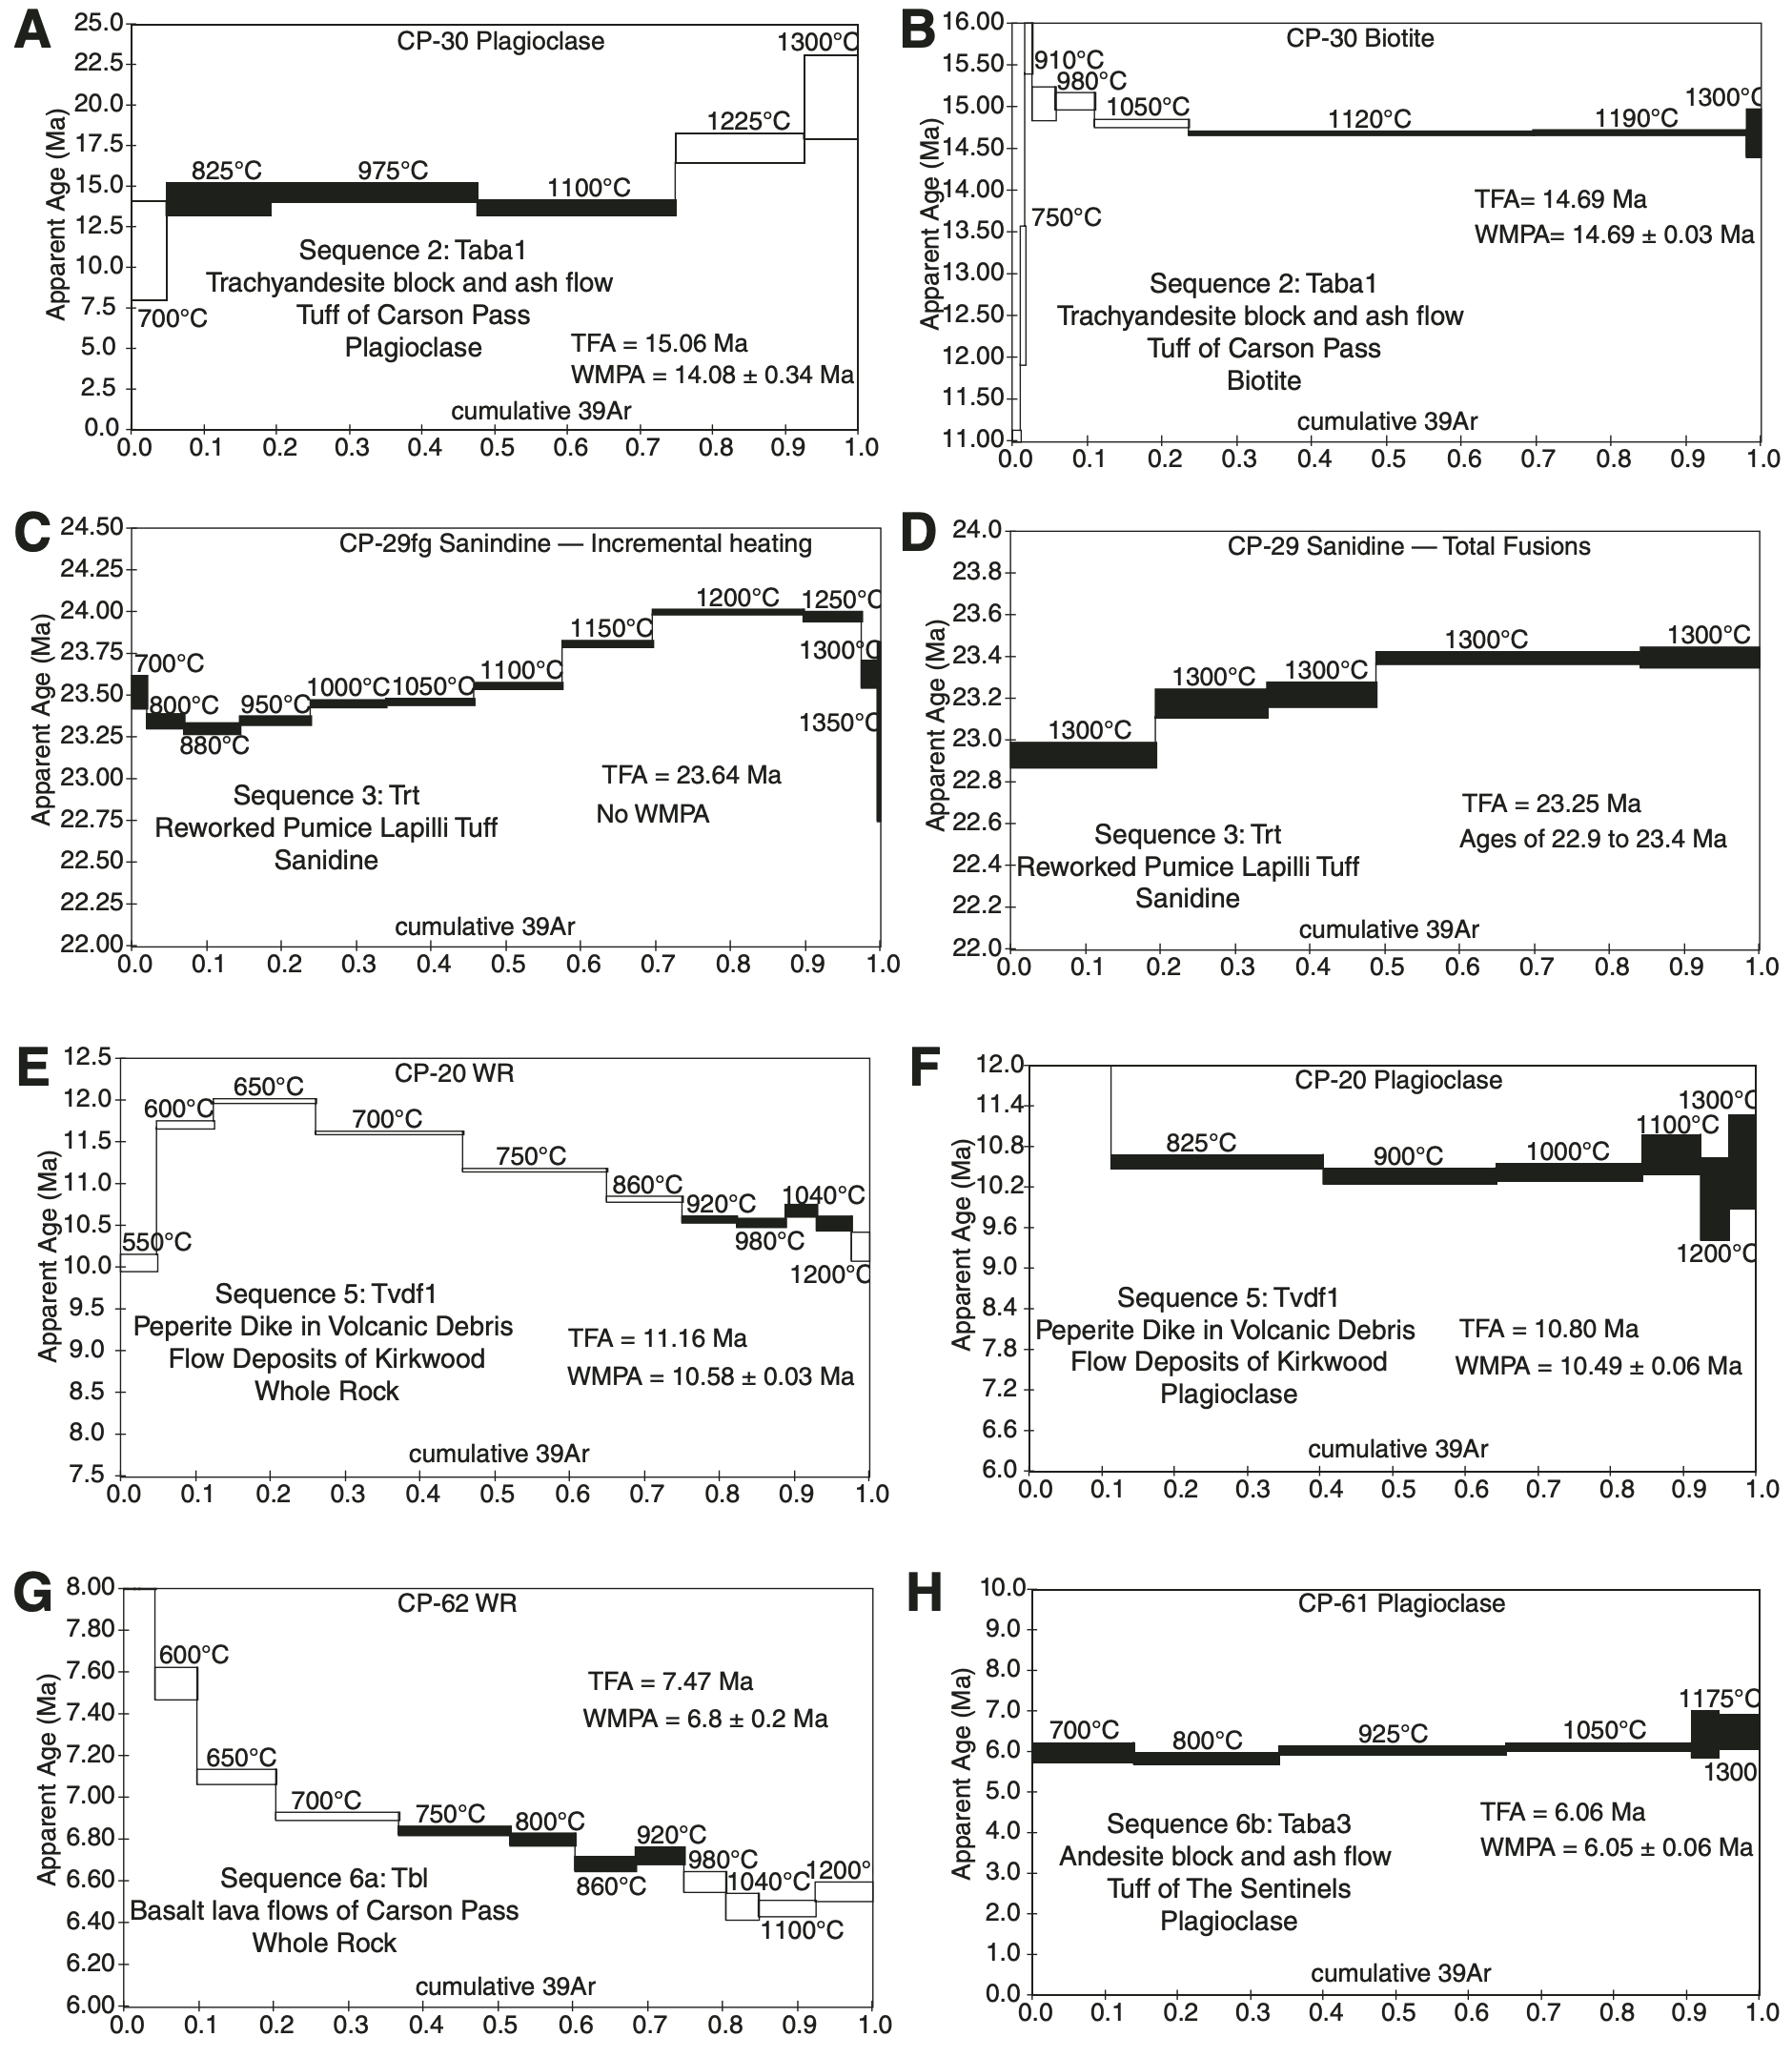
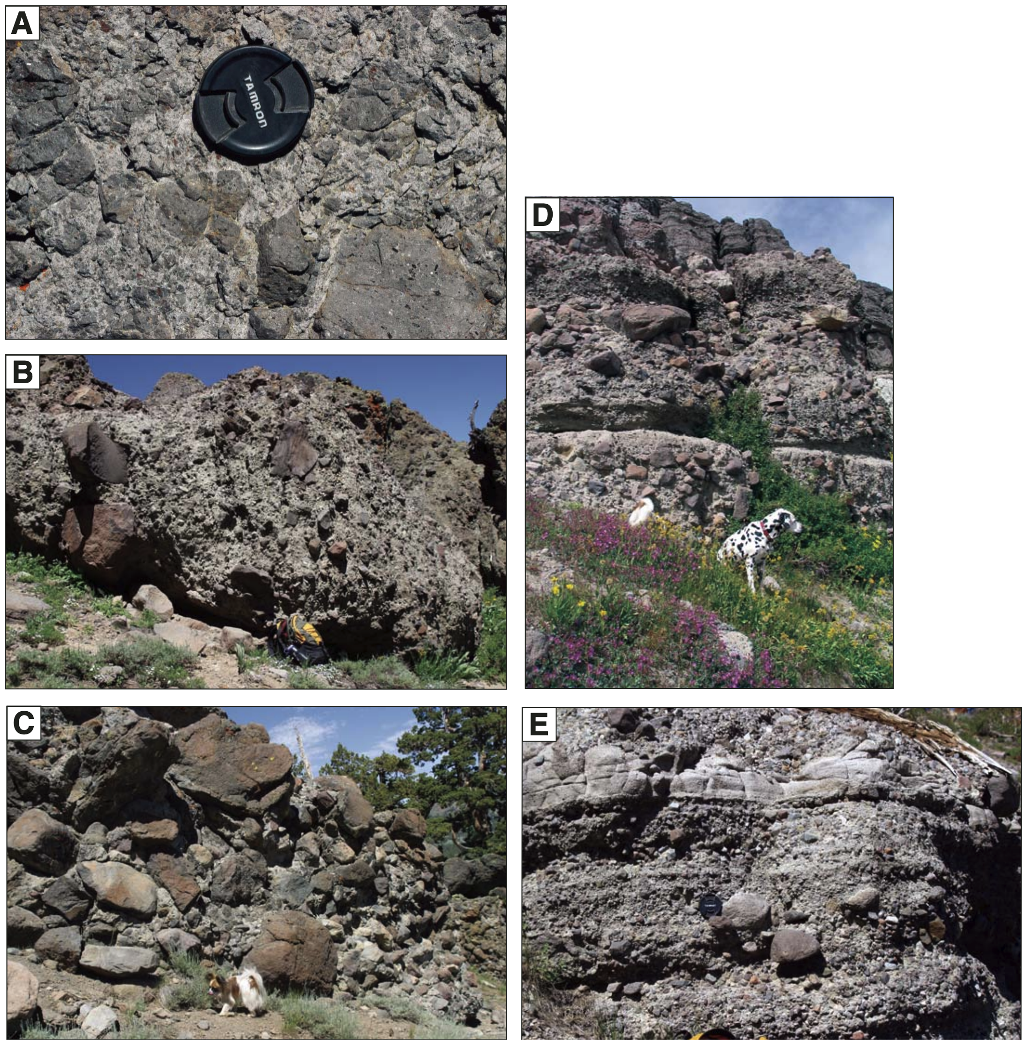
Geochronology

Slide 13
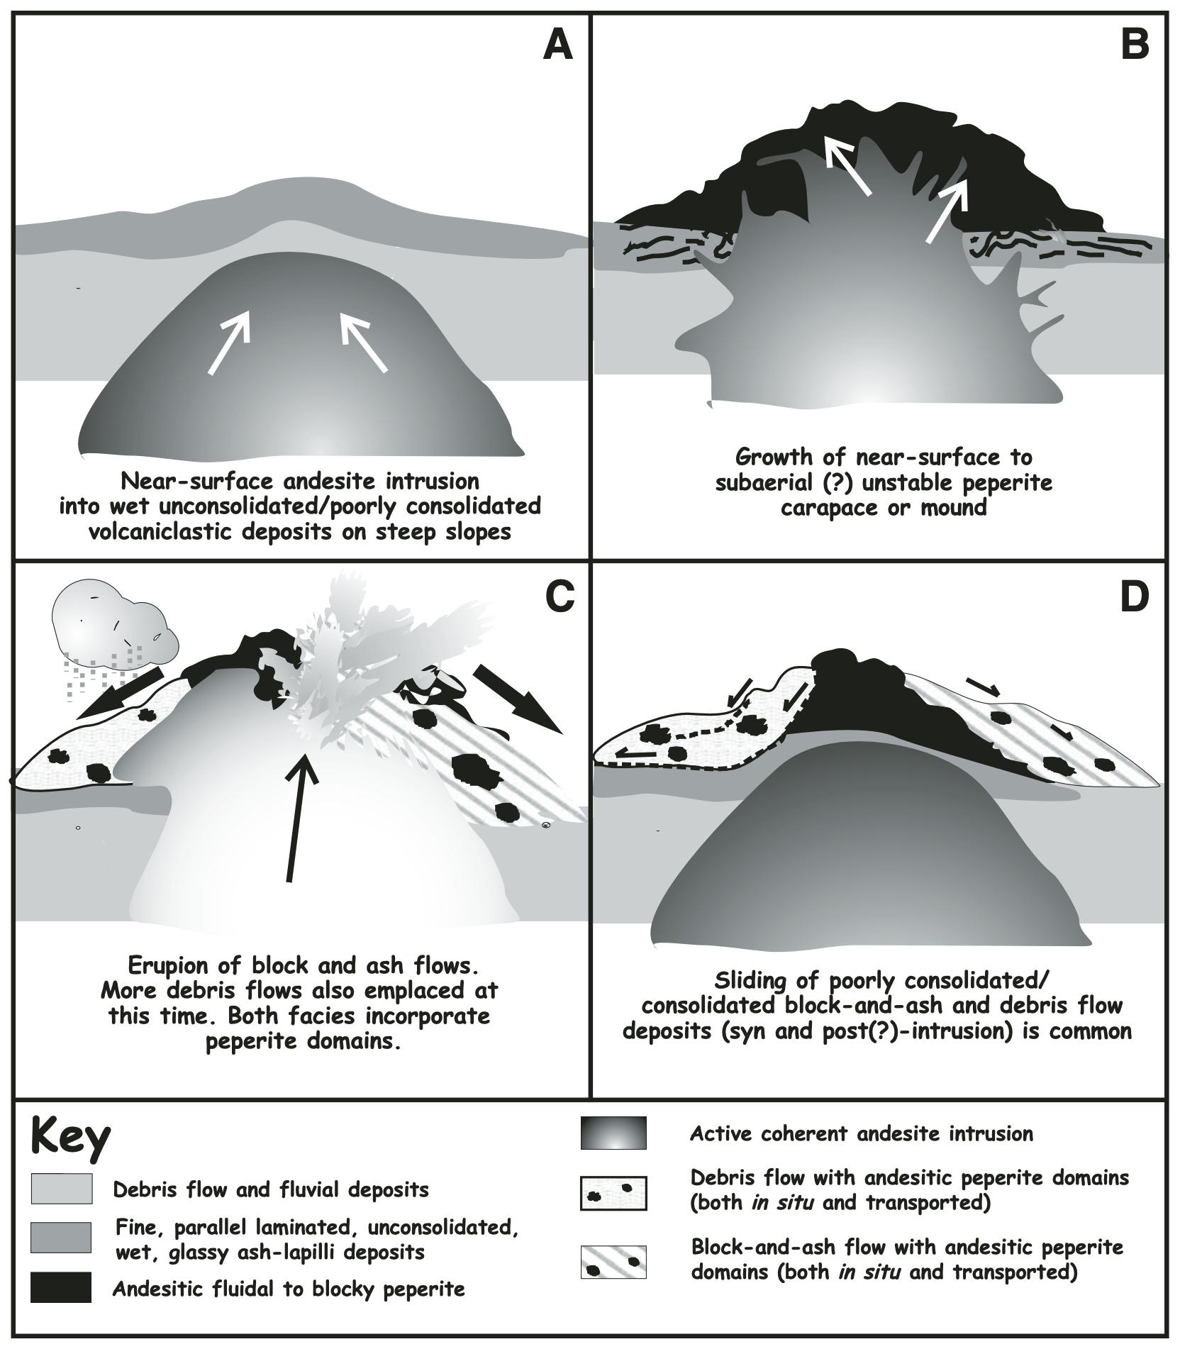
Ancestral Cascades
The Kirkwood area documents the Ancestral Cascades scintillatingly
22-5 MA
3 Pulses of Calc-Alkaline Ancestral Cascade Volcanism
15-14 MA
10-9 MA
7-6 MA
In general, Miocene volcanoes were located along modern Sierra crest in the Kirkwood area
No evidence of Stratovolcanoes or Calderas- I find this very interesting
In Kirkwood area, volcanic debris was deposited near their sources, lacking fine-grained clasts (steep slope)
Volcanic environments characterized by high rates of erosion & clastic deposition in wet setting

Slide 14
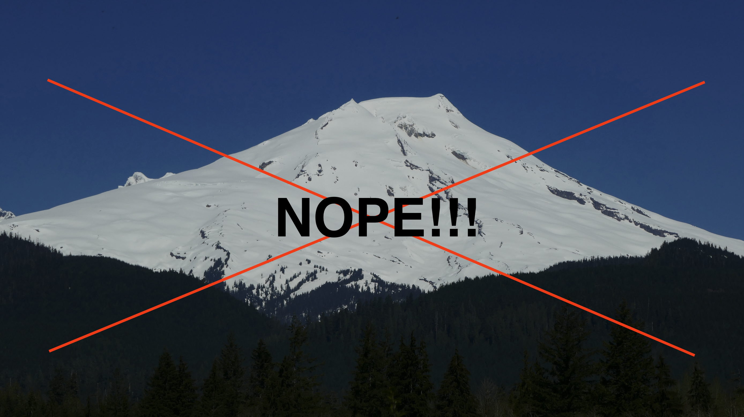

Slide 15
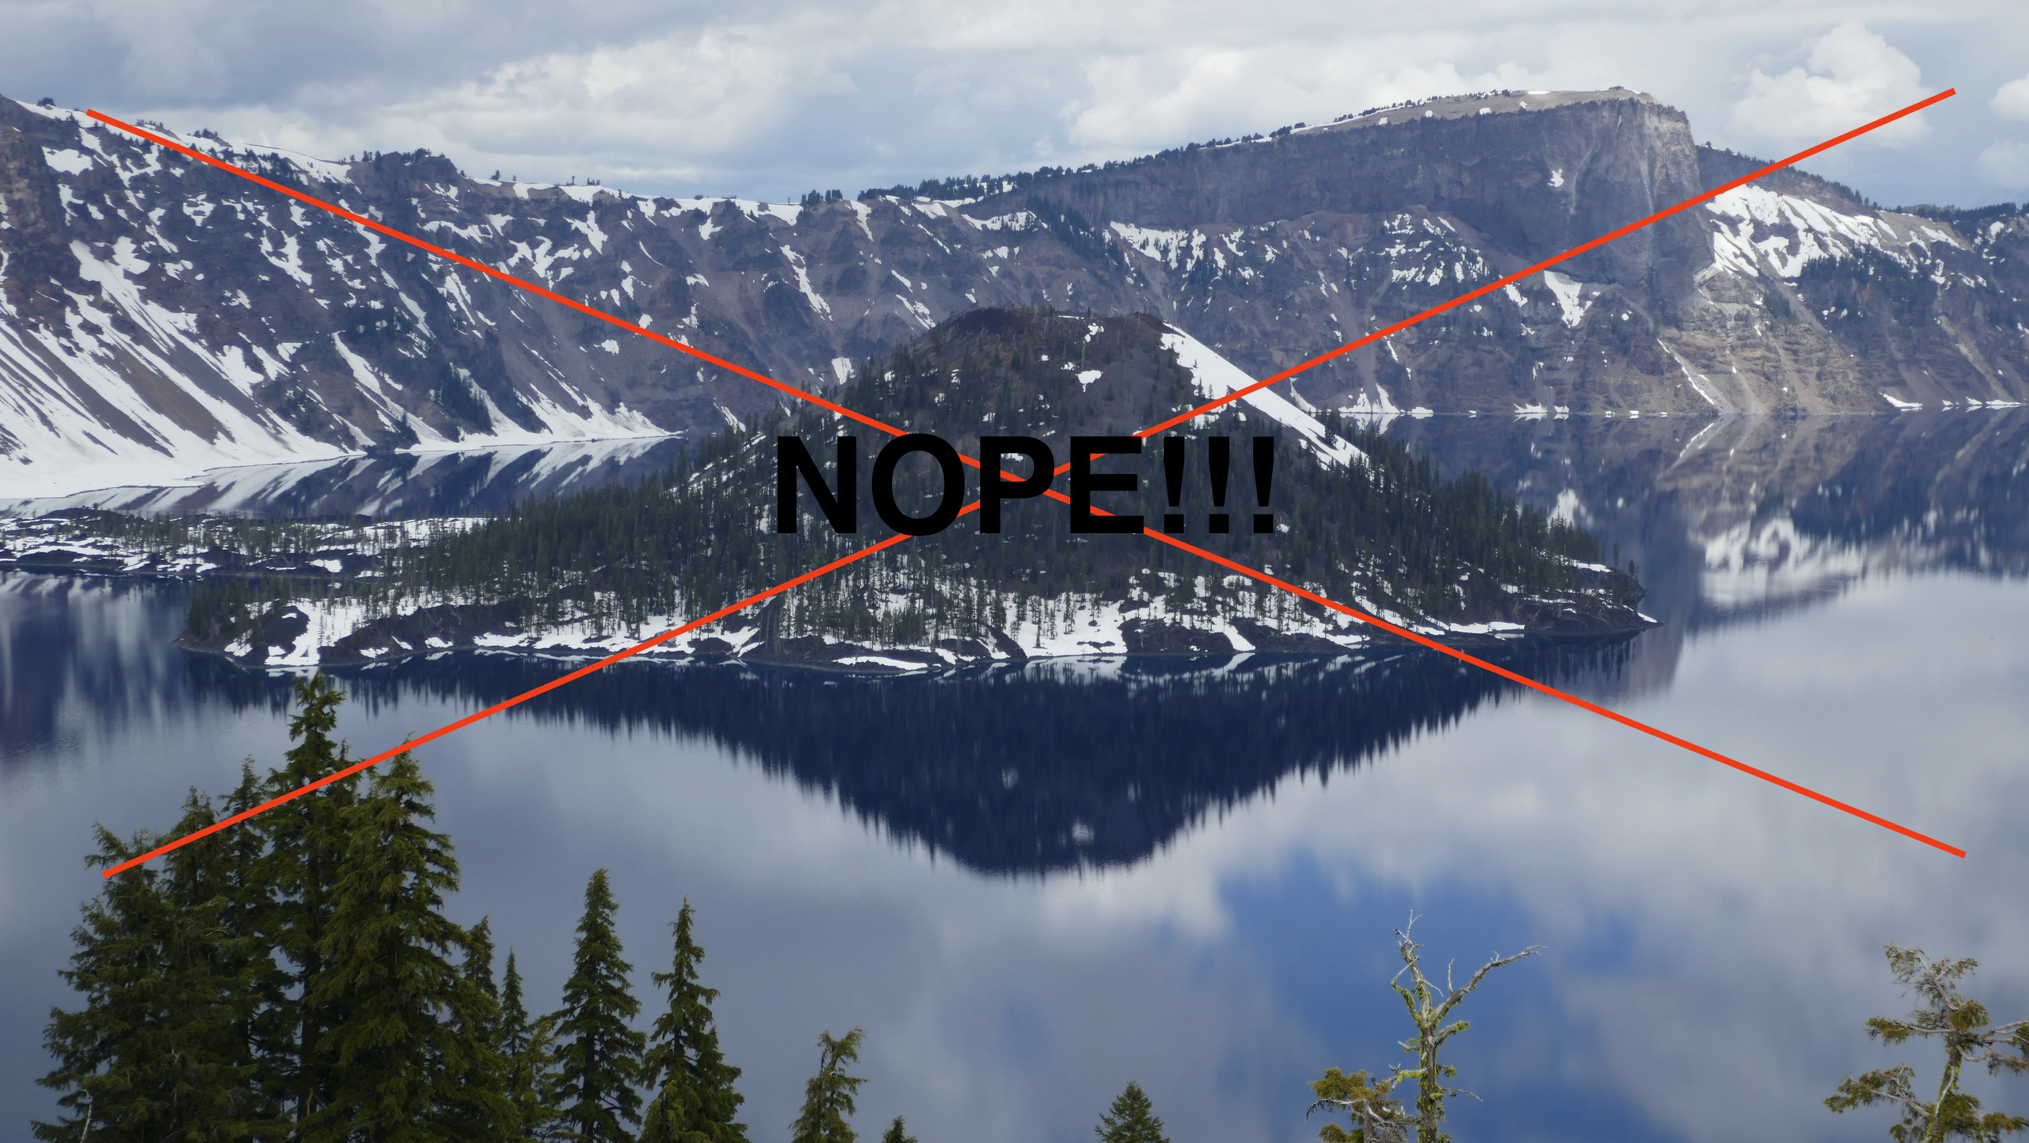

Slide 16
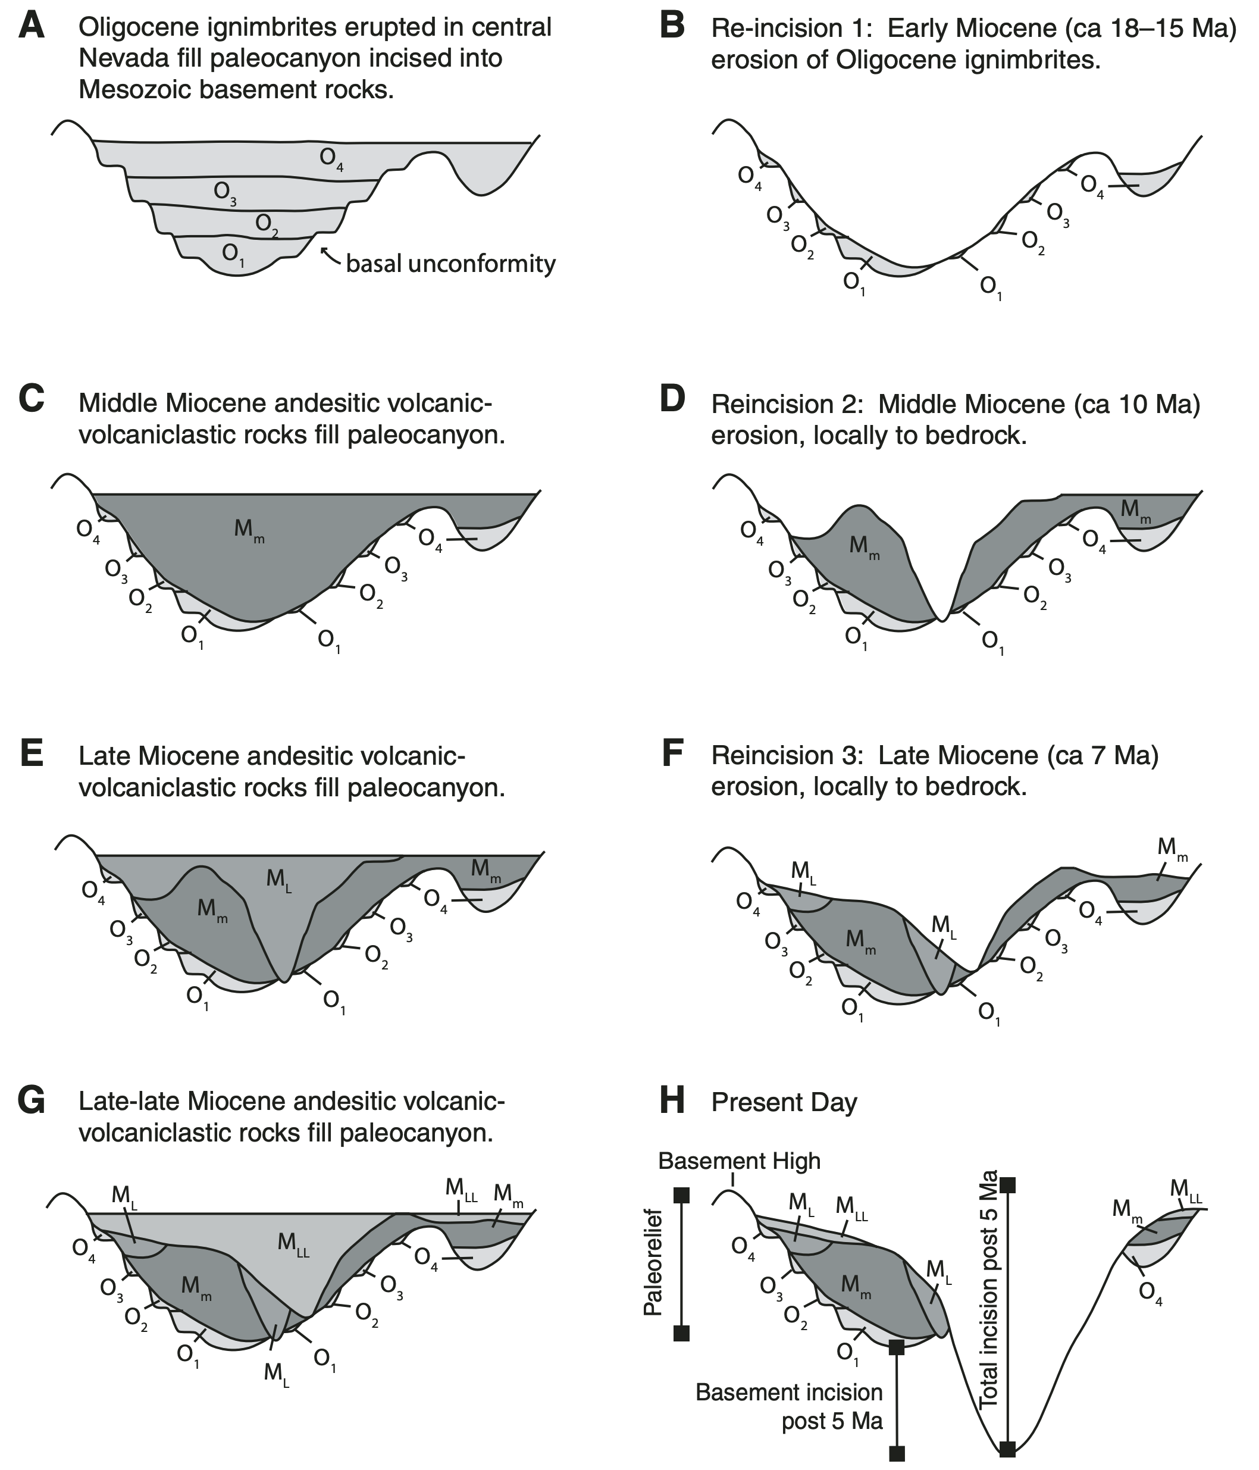
General Landscape
Paleorelief in study area is ~650 m
Low paleorelief in northern Sierras (200m), high in southern Sierras (1000 m)
Absolute elevation in Kirkwood Area 5-10 MA?
900 – 2500 m
Deep weathering of granitic basement during Eocene, volcanic debris from Miocene deposited themselves in these canyons
Study suggests that the slopes in this area at least are much steeper than previously thought- local slopes up to 50º & 70º

Slide 17
General Landscape
Multiple incision events of at least 200-300 m in late Miocene
Surface elevations higher in the Great Basin than the Sierra Nevada during the Oligocene & Miocene
“(at 15-16 MA) The Sierra Nevada may have been no more than the western flank of the high plateau that constituted western Nevada” (Wolfe et al, 1997)
Kirkwood Paleocanyon beheaded 11 MA
Unconformities 2,5 & 6 record tectonic events in central Sierra Nevada, related to arc magmatism

Slide 18
Conclusions
Carson Pass-Kirkwood stratigraphy records 2 volcanic episodes- Oligocene ignimbrite flare up in Central Nevada, and Ancestral Cascades Volcanic Arc from 14-6 MA
3 Pulses of AC Volcanism: 15-14 MA, 10-9 MA, & 7-6 MA
Volcanism took place in Kirkwood vicinity during this time, as volcanic debris flows suggest mainly proximal deposits
No evidence of stratovolcanoes or calderas, mainly just small intrusions and lava dome collapses in wet environments
Carson Pass-Kirkwood Paleocanyon is a nonconformity cut into Mesozoic granitic basement where volcanic debris flowed
Greater local paleorelief than originally thought
My question: Is Carson-Pass Kirkwood applicable to the entire central Sierra Nevada, or is this study only valid locally?
Notes:
Can have subduction zone without stratovolcanoes- if ocean ridge is subducted. Was this happening? By 14-6 MA, San Andreas Fault had already commenced
I think absence of stratovolcanoes and calderas means this study is only applicable locally and not throughout the ancestral cascades.

Slide 19
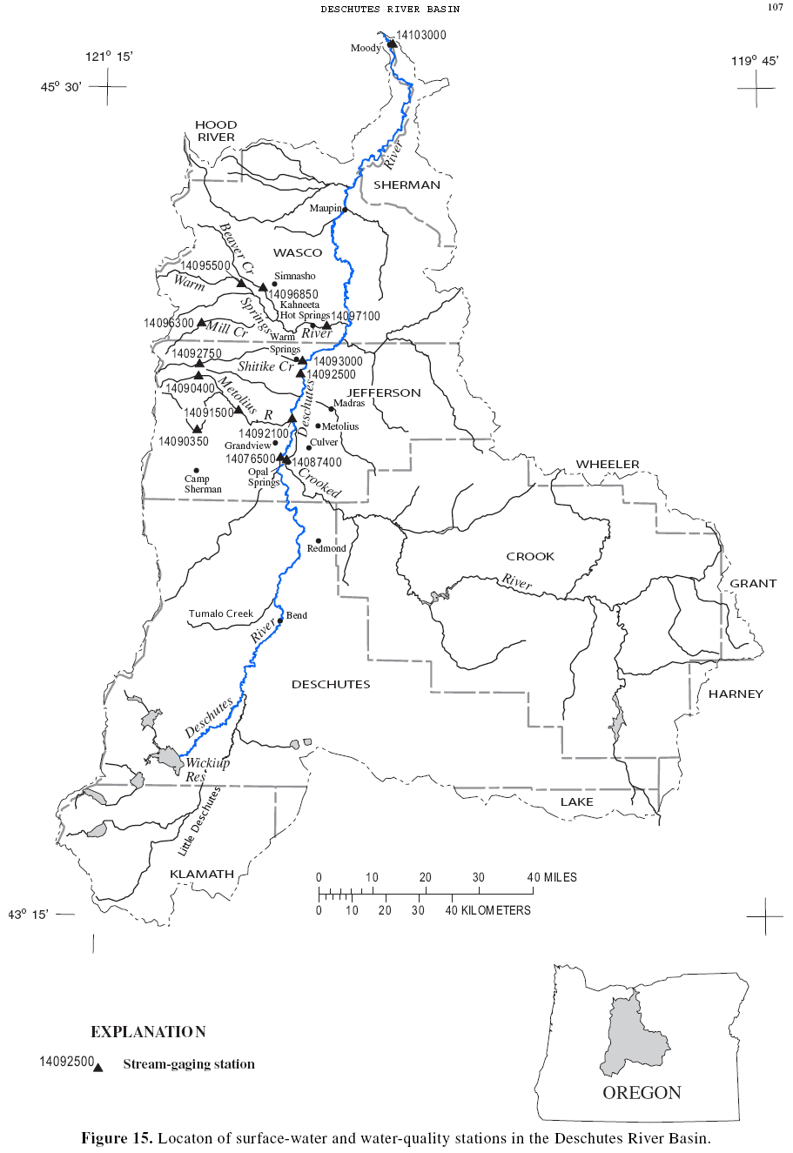
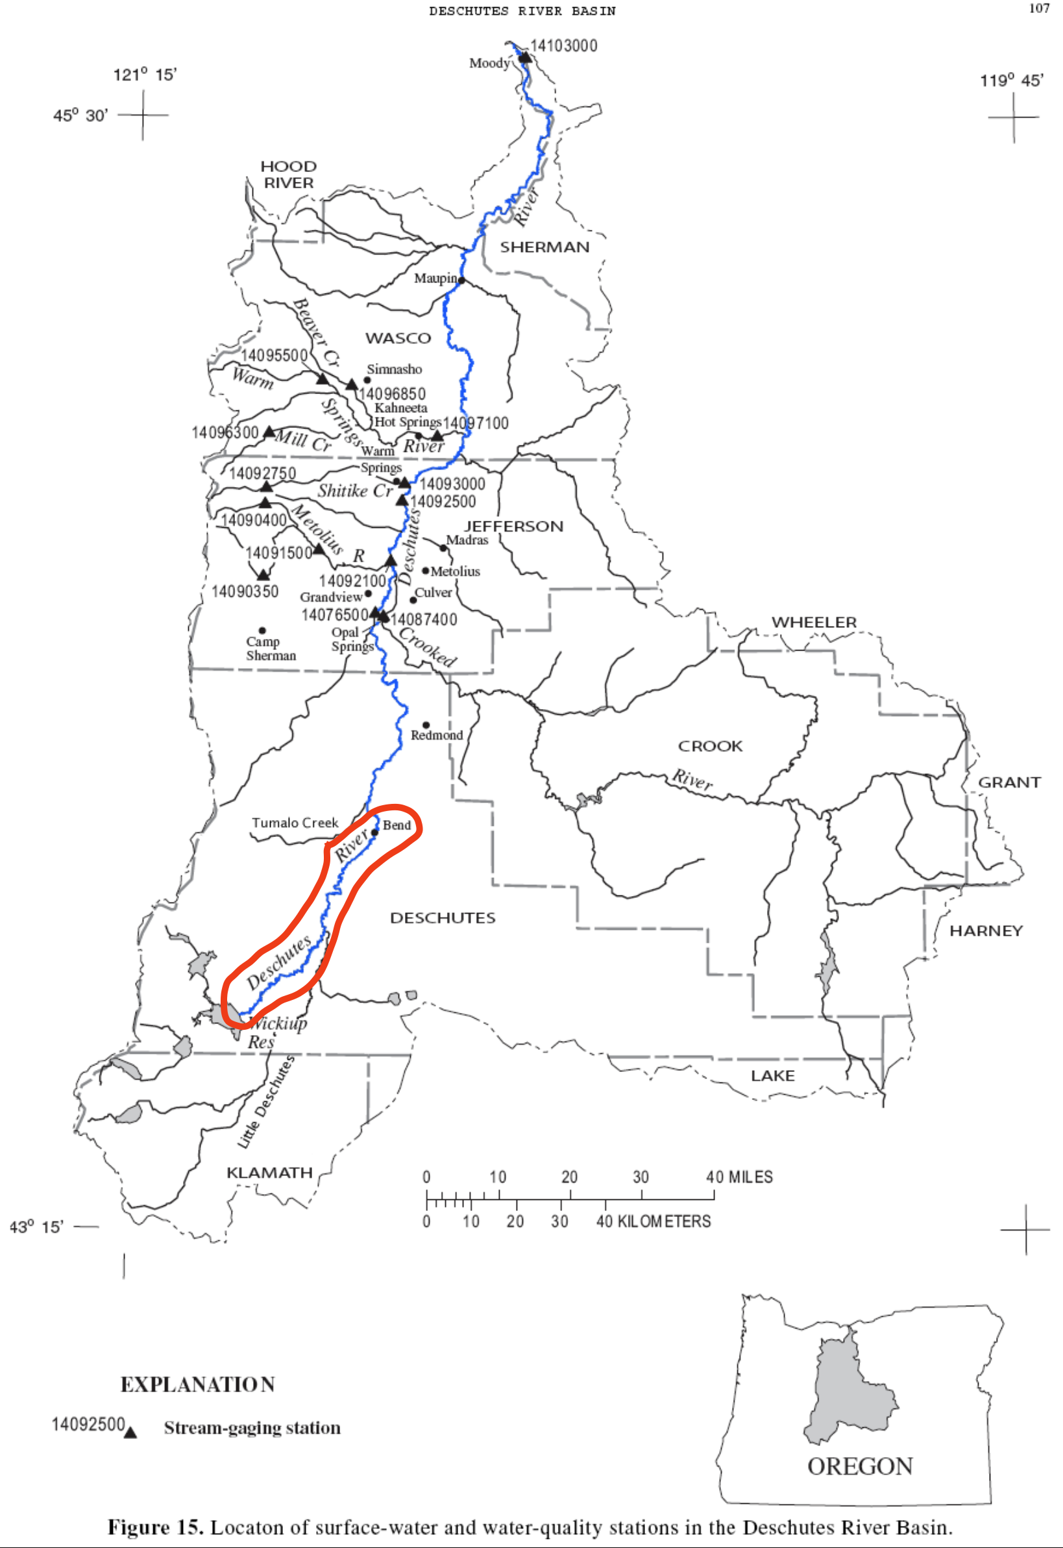
Why I DO NOT believe this study is applicable to the entire Ancestral Cascades
If we had a “Paleocanyon” of this section of the Deschutes River in several million years, it would appear that there were no Stratovolcanoes in the Cascades, since this section of the river cuts Basalt and Andesite flows from Cinder Cones, and the headwaters of the river are NOT downstream of any active Stratovolcano. However…
Notes:
There was a period of erosion recorded in this study too- wouldn’t pyroclastic flows from stratovolcanoes more readily erode than the strata that is deposited?

Slide 20
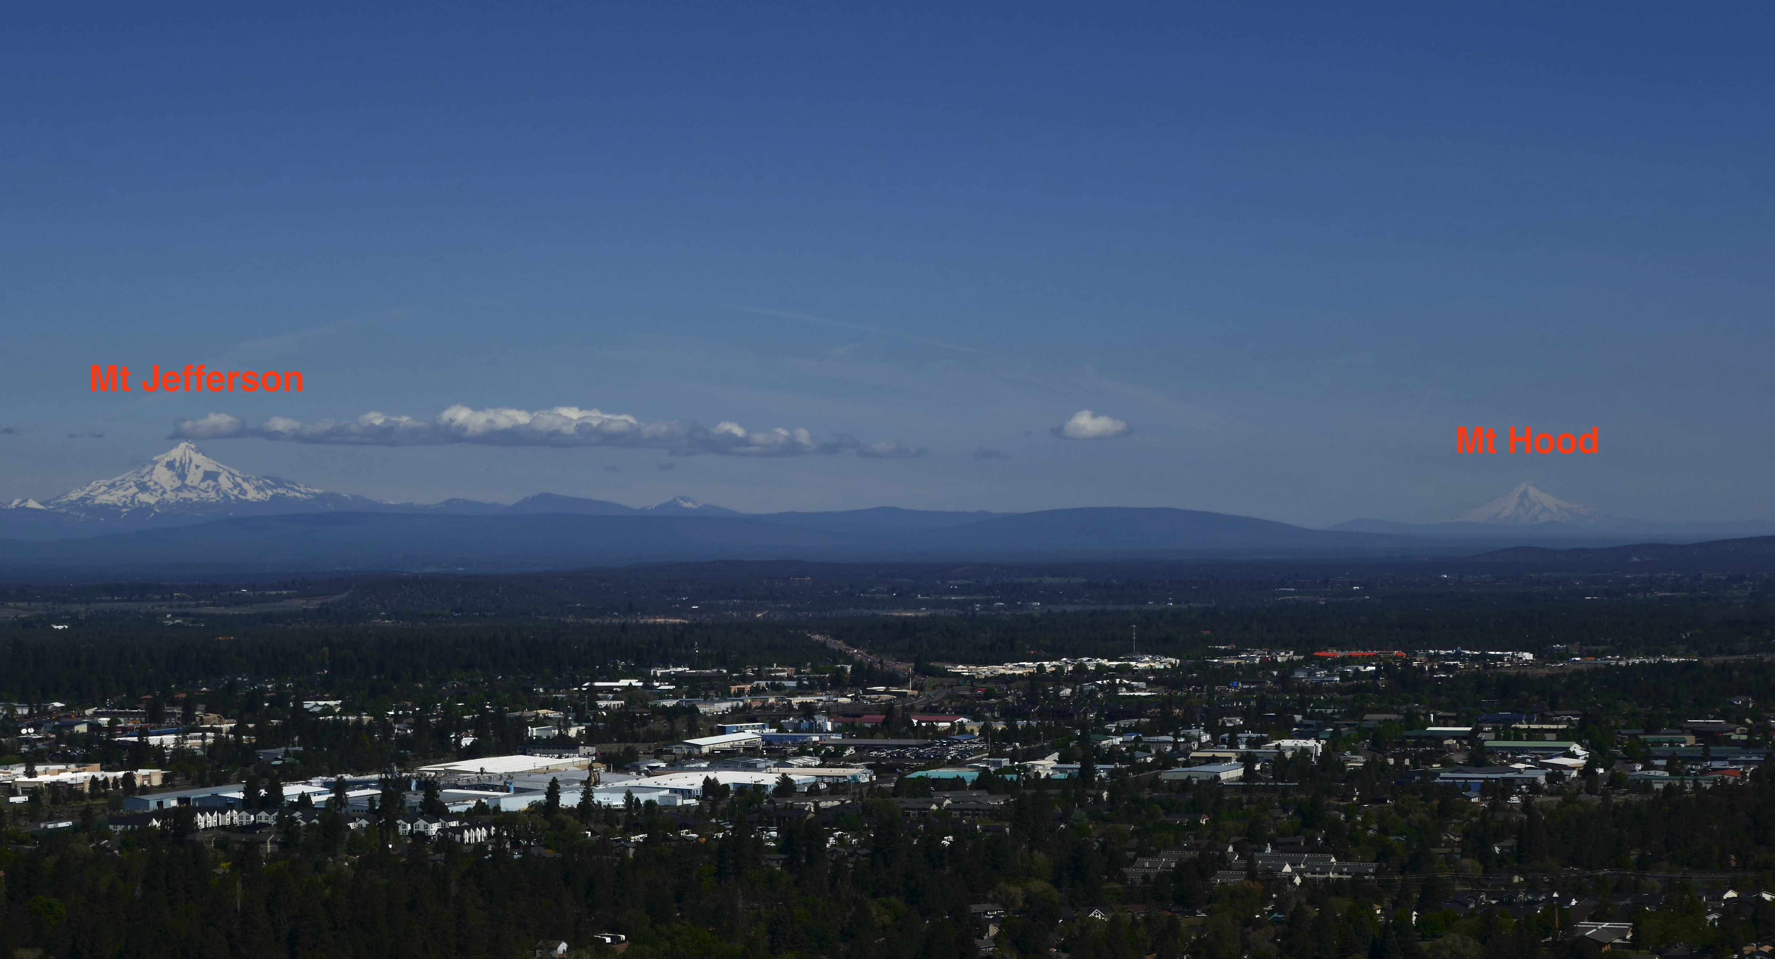

Slide 21
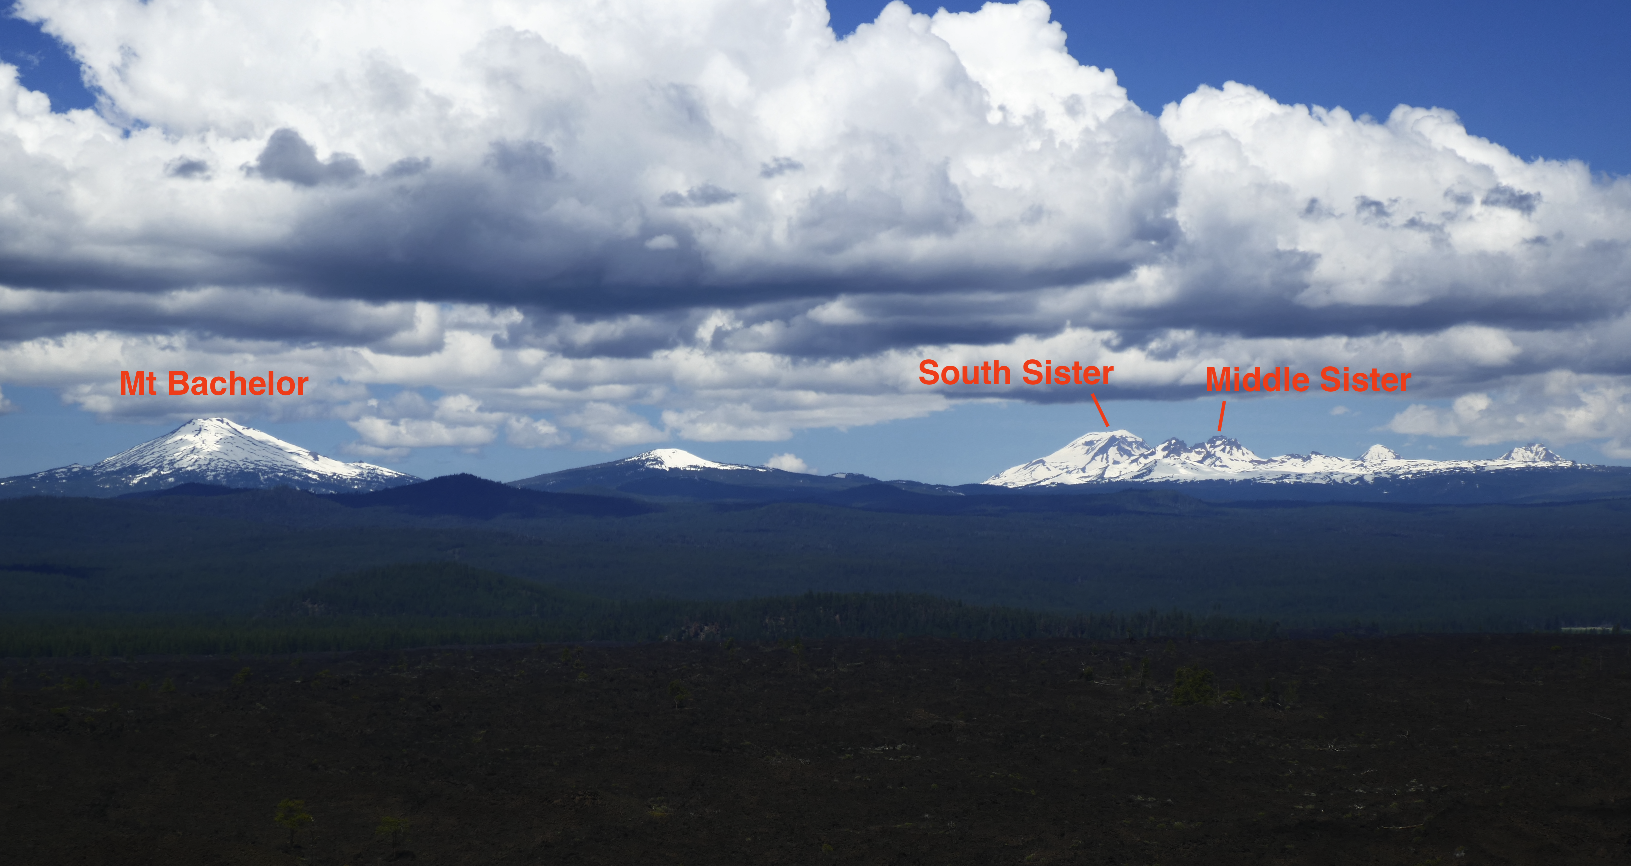

Slide 22
There are several stratovolcanoes near this location of the Deschutes River, just further downstream of our selected section.
Notes:
Busby et al interpret Kirkwood as basically right on the flanks of ancient volcanoes as well, so who knows what was downstream of Kirkwood.

